Slide 1
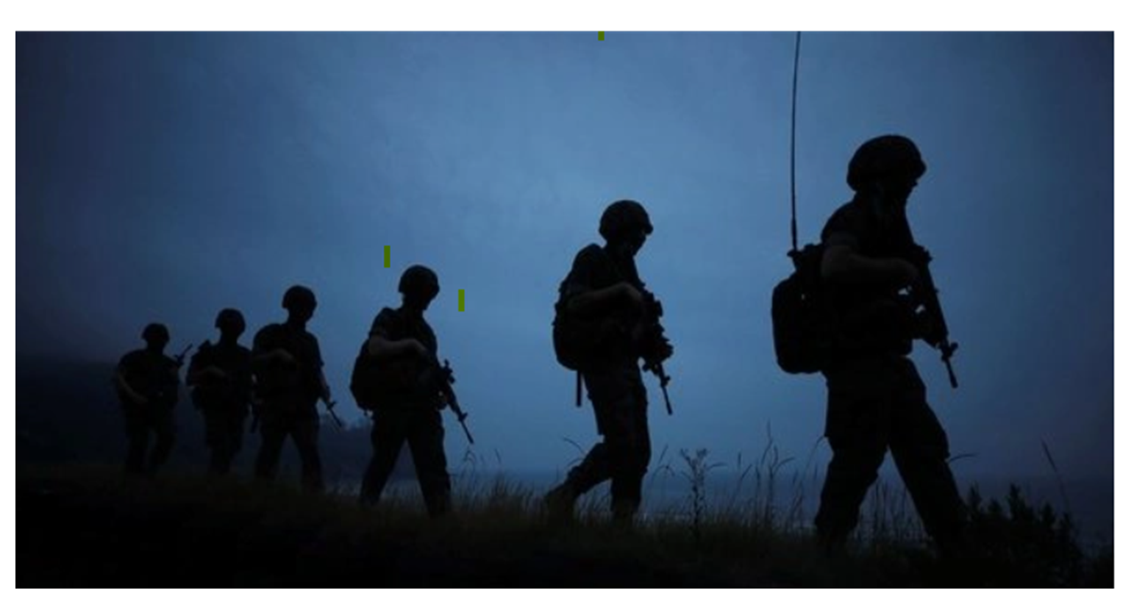


Slide 2


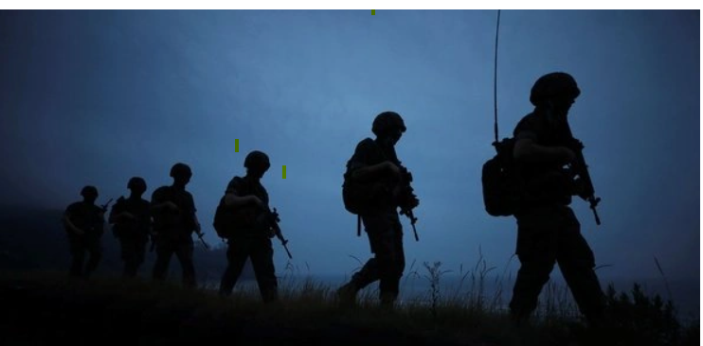
Market Volatility During International Conflicts
Stock market volatility during International conflicts
With the war that is going on in Ukraine and Russia our group decided to see how conflicts/war in the past and present have affected the stock market.
The stock market dataset is from Kaggle and the conflict data is from Uppsala Conflict Data Program – Department of Peace and Conflict Research
What was the market behavior prior to conflict? What is market behavior during conflict? Did the size of the conflict have a proportional impact on the market price? Was a certain sector impacted more than another? Which territory or location was greatly affected and what was minimum, maximum and average market value during the conflict?
Started with reviewing the Kaggle website looking for stock market data then found the Department of Peace and Conflict research website and pulled the conflict dataset. During this analysis phase we had the Nasdaq, Dow Jones, S&P 500, and war dataset.
Description of the analysis phase of the project
Technologies, languages, tools, and algorithms used throughout the project
Group 1

Slide 3
Market Volatility During International Conflicts
Reason topic was selected
With the current situation of Russia’s military invading Ukraine, our team agreed to analyze the volatility of the stock market during war and uncertainty during international conflicts.
Group 1

Slide 4

Market Volatility During International Conflicts
Description of the source of data:
Stock Market data utilized from Kaggle:
https://www.kaggle.com/rishidamarla/stock-prices-over-a-30-year-period
International conflict database from Uppsala Conflict Data Program
- Department of Peace and Conflict Research:
https://ucdp.uu.se/downloads/ucdpprio/ucdp-prio-acd-211.pdf
Other website resources:
https://www.investopedia.com/solving-the-war-puzzle-4780889
Group 1

Slide 5
Market Volatility During International Conflicts
Questions the team hopes to answer with the data
Does the size of the conflict have proportional impact?
Does the geographical location matter?
Was a certain sector impacted more than another?
Does the market bounce back after 90 days from the start of the conflict?
5. Which territory or location was greatly affected by and what was minimum, maximum and average market value during the conflict.
Group 1

Slide 6
Market Volatility During International Conflicts
Description of the data exploration phase of the project:
First we searched Kaggle to find stock market data for the 3 markets Dow Jones, Nasdaq, and S&P 500. Next we searched for conflicts and found the Uppsala Conflict Data Program – Department of Peace and Conflict Research website. This is a great website with multiple datasets of conflict data.
Group 1

Slide 7
Market Volatility During International Conflicts
Description of the analysis phase of the project:
Data was downloaded and cleaned. The cleaning and merging process has been very challenging. The dates of the conflicts versus the dates of the market data do not align easily as it is weekly not daily. Narrowing the conflict data has been a timely process with many listed without dates along with conflict details. Challenges have been in date formatting between files and aligning them together
Group 1

Slide 8
Market Volatility During International Conflicts
Description of the analysis phase of the project
Group 1

Slide 9

Group 1
Market Volatility During International Conflicts
Technologies, languages, tools, and algorithms used throughout the project
Appplications used:
Excel
Python
Postgres SQL/Pgadmin
AWS
Tools:
QuickDBD for ERD Diagram
Google Slides /Powerpoint
Algorithms:
Machine Learning/Neural Network

